Slide 1


4. Creative Awards
401. Telecom Products and Services
Uninor - Sabse Sasta warna Mooch Saaf

Slide 2
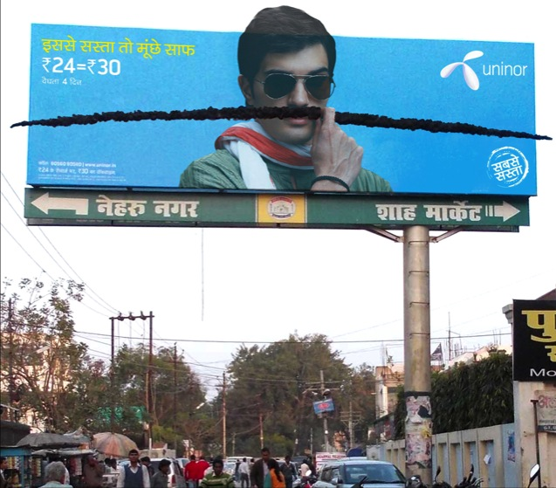

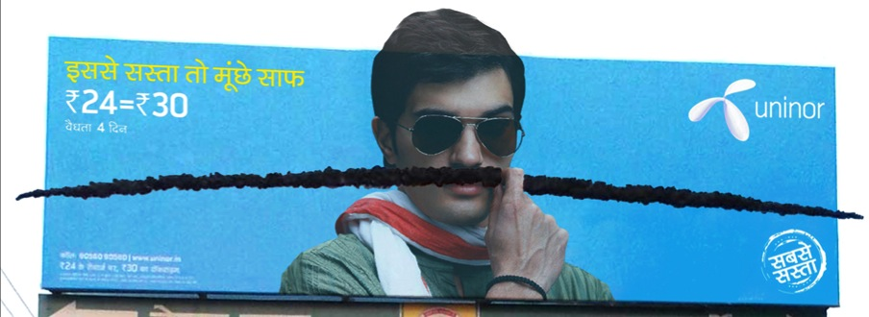
OBJECTIVE
In the target markets of UP small towns and cities the moustache is considered to be a sign of honour, vitality and pride. "Mooch nahin to kuch nain" (No Moustache, No Pride) is the common belief. Uninor as a brand wanted to promote their new lucrative and reach out to the common masses as ‘Sabse Sasta’
Being a brand with an innovative bent of mind, Uninor wanted to play this with light humour keeping the ‘commitment’ aspect in mind. The objective was to stand out as a differentiator in the cluttered market of telecom, choosing a very distinct approach.

Slide 3
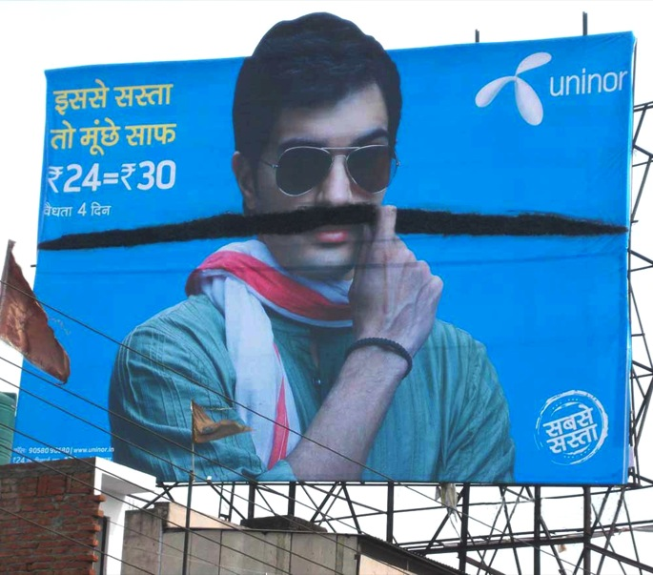
CREATIVE STRATEGY
The campaign rolled out with innovative billboards of a man and an actual moustache on him. Actual moustache’s going from one end of the billboard to the other were humorously glued onto the man’s face. The main executional challenge was to create, develop a long moustache that would give the look and feel of real moustache.
The strategy employed was to paint the town with the same creative concept to capture maximum audience attention.

Slide 4


EFFECTIVENESS
The out-of-home plan reached more than 100 touch points across various cities in West and East UP namely Agra, Moradabad, Bareilly, Meerut, Dehradun and so on. Besides UP the campaign was also rolled out in ROM (Rest of Maharashtra) Telenor claims its recharge business jumped 36% in six towns in the UP-West circle where the company recently placed advertisements.
We created a clutter breaking campaign which helped to break the barrier of tariff related queries. It worked well for the brand wherein the sales improved over the weeks. For UP (W), the Brand Scores went up from 56 to 58. The campaign also had a positive effect in UP (E), with the increase in scores to 45. (With respect to the Brand Track)

